Slide 1


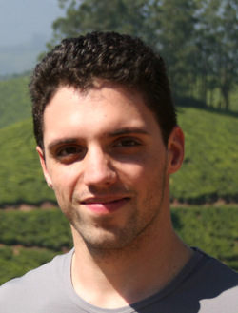
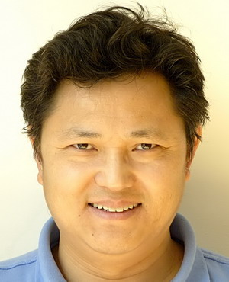
Semantic Embedding Space for Zero ­Shot Action Recognition
Computer Vision Group
Queen Mary University of London
Authors:
Xun Xu
Timothy Hospedales
Shaogang Gong

Slide 2
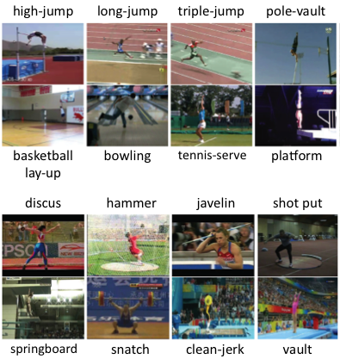
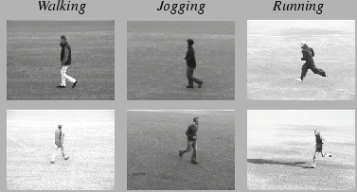
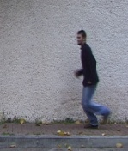
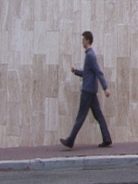
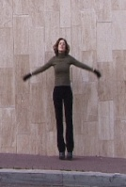
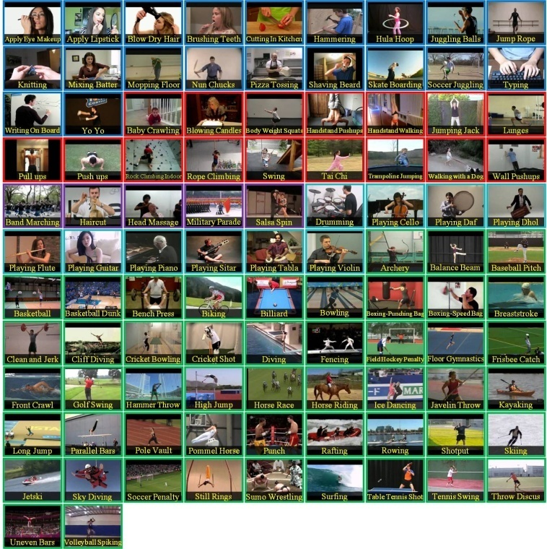
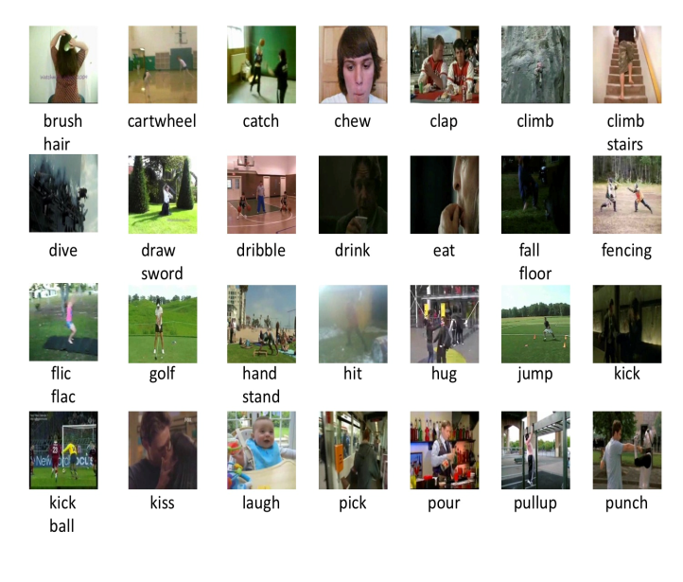
Action Recognition
Ever Increasing #Categories
Limitations
Expensive to collect training data
Annotating video is costly
2004
2005
Weizmann 9 Classes
2010
KTH 6 Classes
Olympic Sports 16 Classes
2011
2012
UCF101 101 Classes
HMDB51 51 Classes

Slide 3
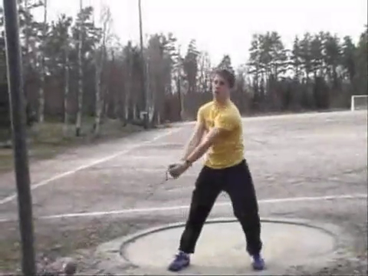
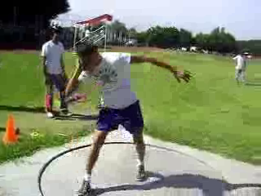
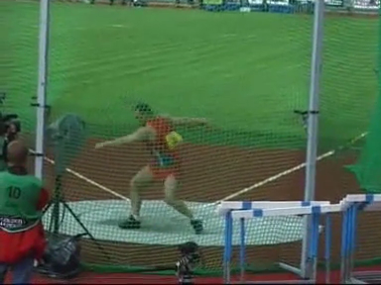
Zero-Shot Action Recognition
Can we use videos from seen class to help predict videos from unseen classes?
Known Classes
Unknown Classes
Shot-Put
Discus
Throw
Hammer
Throw

Slide 4
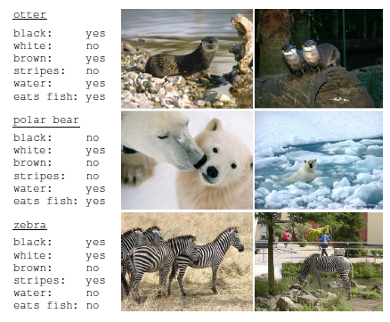
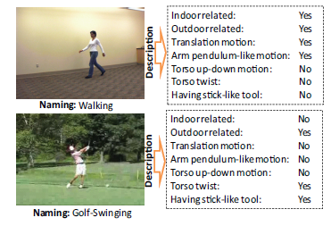
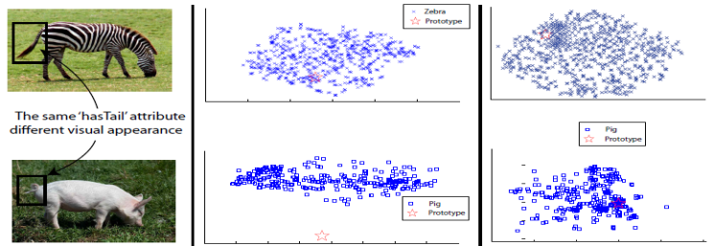
Conventional Approaches
Approaches
Human labelled attributes
Human Labelled Attributes
Limitations
Manual label is costly
Ontological problem
Incompatible with other attribute sets
Fu etal. TPAMI15 [3]
Lampert etal. CVPR09 [1]
Liu etal. CVPR11 [2]
[1] Lampert etal. Learning to detect unseen object classes by between-class attribute transfer, CVPR2009
[2] J. Liu, B. Kuipers, and S. Savarese, “Recognizing human actions by attributes,” CVPR, 2011.
[3] Fu Y, Hospedales TM, Xiang T, Gong S. Transductive Multiview Zero-Shot Learning. IEEE Transactions on Pattern Analysis and Machine Intelligence 2015;.

Slide 5

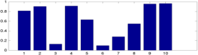


Conventional Approaches
Attribute Based
Limitations
Manual label is costly
Ontological problem
Incompatible with other attribute sets
Discus
Throw
Throw Away
Outdoor
Hammer
Throw
Turn Around
Ball
Shot-put
Bend

Slide 6
Semantic Embedding Approach
Feature Space
Semantic Embedding Space
Discus
Throw
Discus Throw = [0.2 0.5 0.1 …]
Hammer Throw = [0.1 0.6 0.1 …]
Hammer
Throw
ShotPut = [0.3 0.4 0.2 …]

Slide 7

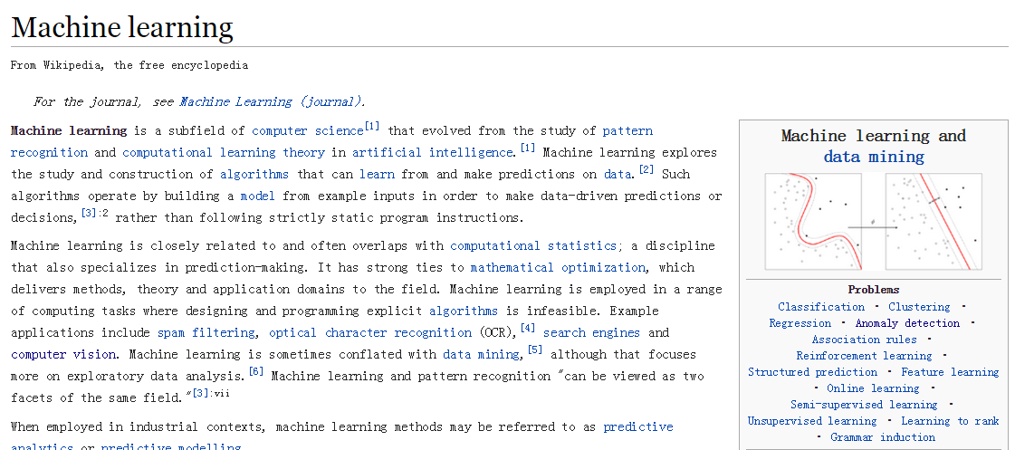
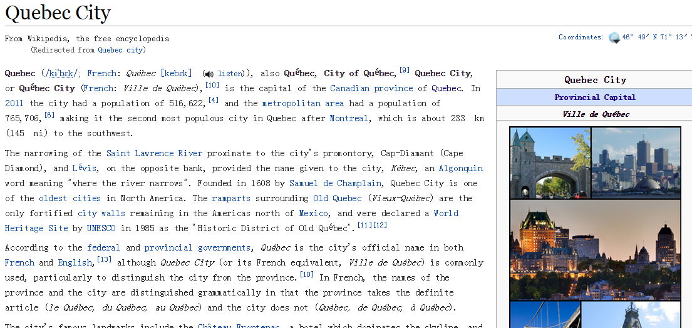
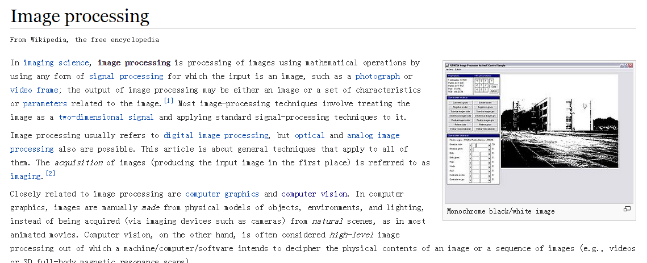
Benefit
Unsupervised Semantic Space

Slide 8
Benefits
Unsupervised
Wide coverage of words
Vec(“Apple”) = [0.2 0.3 0.1 …]
Vec(“Bear”) = [0.1 0.9 0.1 …]
Vec(“Car ”) = [0.6 0.2 0.4 …]
Vec(“Desk”) = [0.2 0.8 0.4 …]
Vec(“Fish”) = [0.5 0.2 0.3 …]
…

Slide 9
Benefits
Unsupervised
Wide coverage of words
Semantic Meaningful
Semantic Embedding Space
ship
Run
cat
Walk
dog

Slide 10
Benefits
Unsupervised
Wide coverage of words
Semantic Meaningful
Uniform across datasets
Dataset 1
Dataset 2
Discus Throw = [0.2 0.5 …]
Discus Throw = [0.2 0.5 …]
HammerThrow = [0.1 0.2 …]
HammerThrow = [0.1 0.2 …]

Slide 11
Challenges
Complex Mapping

Slide 12
Challenges
Feature Space
Semantic Vector Space
N dim
Discus Throw = [0.2 0.5 0.1 …]
D dim
HammerThrow = [0.1 0.6 0.1 …]
N dim
D dim

Slide 13
Challenges
Domain Shift

Slide 14
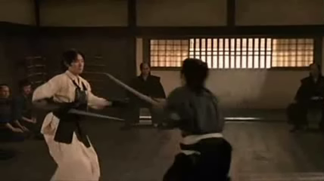
Challenges
Feature Space
Semantic Vector Space
Discus
Throw
Discus Throw
HammerThrow
Hammer
Throw
Sword Exercise
Play Guitar

Slide 15
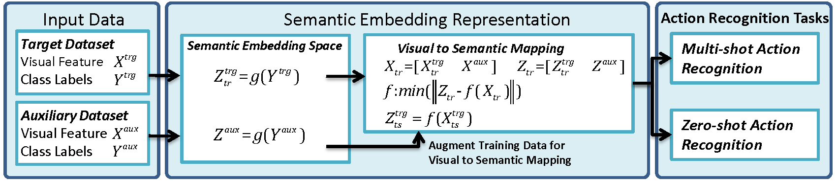
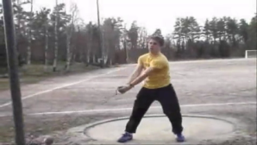
Semantic Embedding Approach
Y=“Discus Throw”
Y = “Discus Throw”

Slide 16
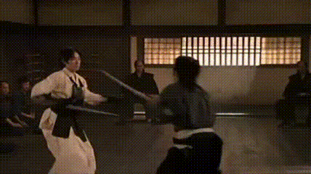
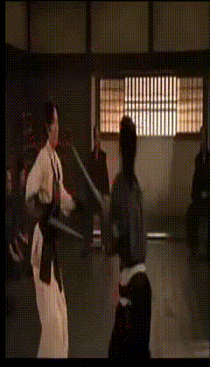
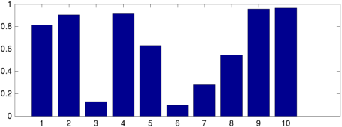
Low-Level Visual Feature
Improved Trajectory Feature [1]
Bag of Words encoding
[1] H Wang, C Schmid, Action recognition with improved trajectories, ICCV13

Slide 17
Semantic Embedding Space
Y=“Discus Throw”

Slide 18
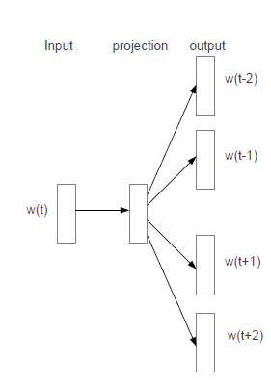
Semantic Word Vector
Skip-gram model [1] predicts nearby words
archery | 0.04 0.01 0.01 -0.03 0.05
hammer | 0.16 0.06 0.09 -0.06 -0.02
sword | 0.02 0.01 0.02 -0.03 -0.03
throw | -0.08 -0.1 0.15 -0.01 0.09
… | …
[1] Mikolov, Tomas, et al. "Distributed representations of words and phrases and their compositionality.“ NIPS2013

Slide 19
Combinations of Multi Words
Additive Composition
vec(“Discus Throw”) = vec(“Discus”) + vec(“Throw”)
vec(“Apply Eye Makeup”) = vec(“Apply”) + vec(“Eye”) + vec(“Makeup”)
vec(“Playing Guitar”) = vec(“Playing”) + vec(“Guitar”)

Slide 20
Visual to Semantic Mapping

Slide 21
Visual to Semantic Mapping
Support Vector Regression with Chi2 Kernel
x1
z1
x2
N dim
z2
D dim
x3
……
…

Slide 22
Semantic Word Vector Approach

Slide 23
Zeroshot Recognition
Do nearest Neighbor search to predict category of test data
Semantic Embedding Space
HulaHoop
Fencing
Basketball
Diving
TestData
Kayaking
Minimal distance
Rafting
TaiChi

Slide 24
Domain Shift – Self Training
Self-training is applied to tackle domain shift
Semantic Embedding Space
Z2
Z3
is the KNN function
Z1
Z4
4 NN example
Z5
Z7
Z8
Z6

Slide 25
Domain Shift – Data Augmentation
Target Dataset Train (HMDB Train)
Augmented Train
Visual
Prototypes
Visual
Prototypes
Auxiliary Dataset Train (UCF)
Visual
Prototypes
Visual
Prototypes
Target Dataset Test(HMDB Test)

Slide 26
Experiments
Dataset:
HMDB51 – 51 classes 6766 videos
UCF101 – 101 classes 13320 videos
Feature:
Improved Trajectory Feature [1]
Bag of Words encoding
Semantic Embedding Space:
Skip-gram neural network model trained on Google News Dataset
300 dimension word vector
[1] Wang, Heng, and Cordelia Schmid. "Action recognition with improved trajectories.“ ICCV 2013.
[2] Perronnin, Florent, Jorge Sánchez, and Thomas Mensink. "Improving the fisher kernel for large-scale image classification." ECCV 2010

Slide 27
Zeroshot Recognition
DataSplits: Random 50/50 split, 30 times
Evaluation: Average + Deviation Mean Classification Accuracy
Dataset | Training Classes | Testing Classes
HMDB51 | 26 | 25
UCF101 | 51 | 50

Slide 28
Zeroshot Experiment
Models
Baselines:
Random Guess
Nearest Neighbour Classifier (NN)
NN with Self-Training (NN+ST)
NN with Data Augmentation (NN + Aux)
NN with ST and Aux (NN+ST+Aux)
Comparison of models:
Direct Attribute Prediction (DAP)
Indirect Attribute Prediction (IAP)

Slide 29
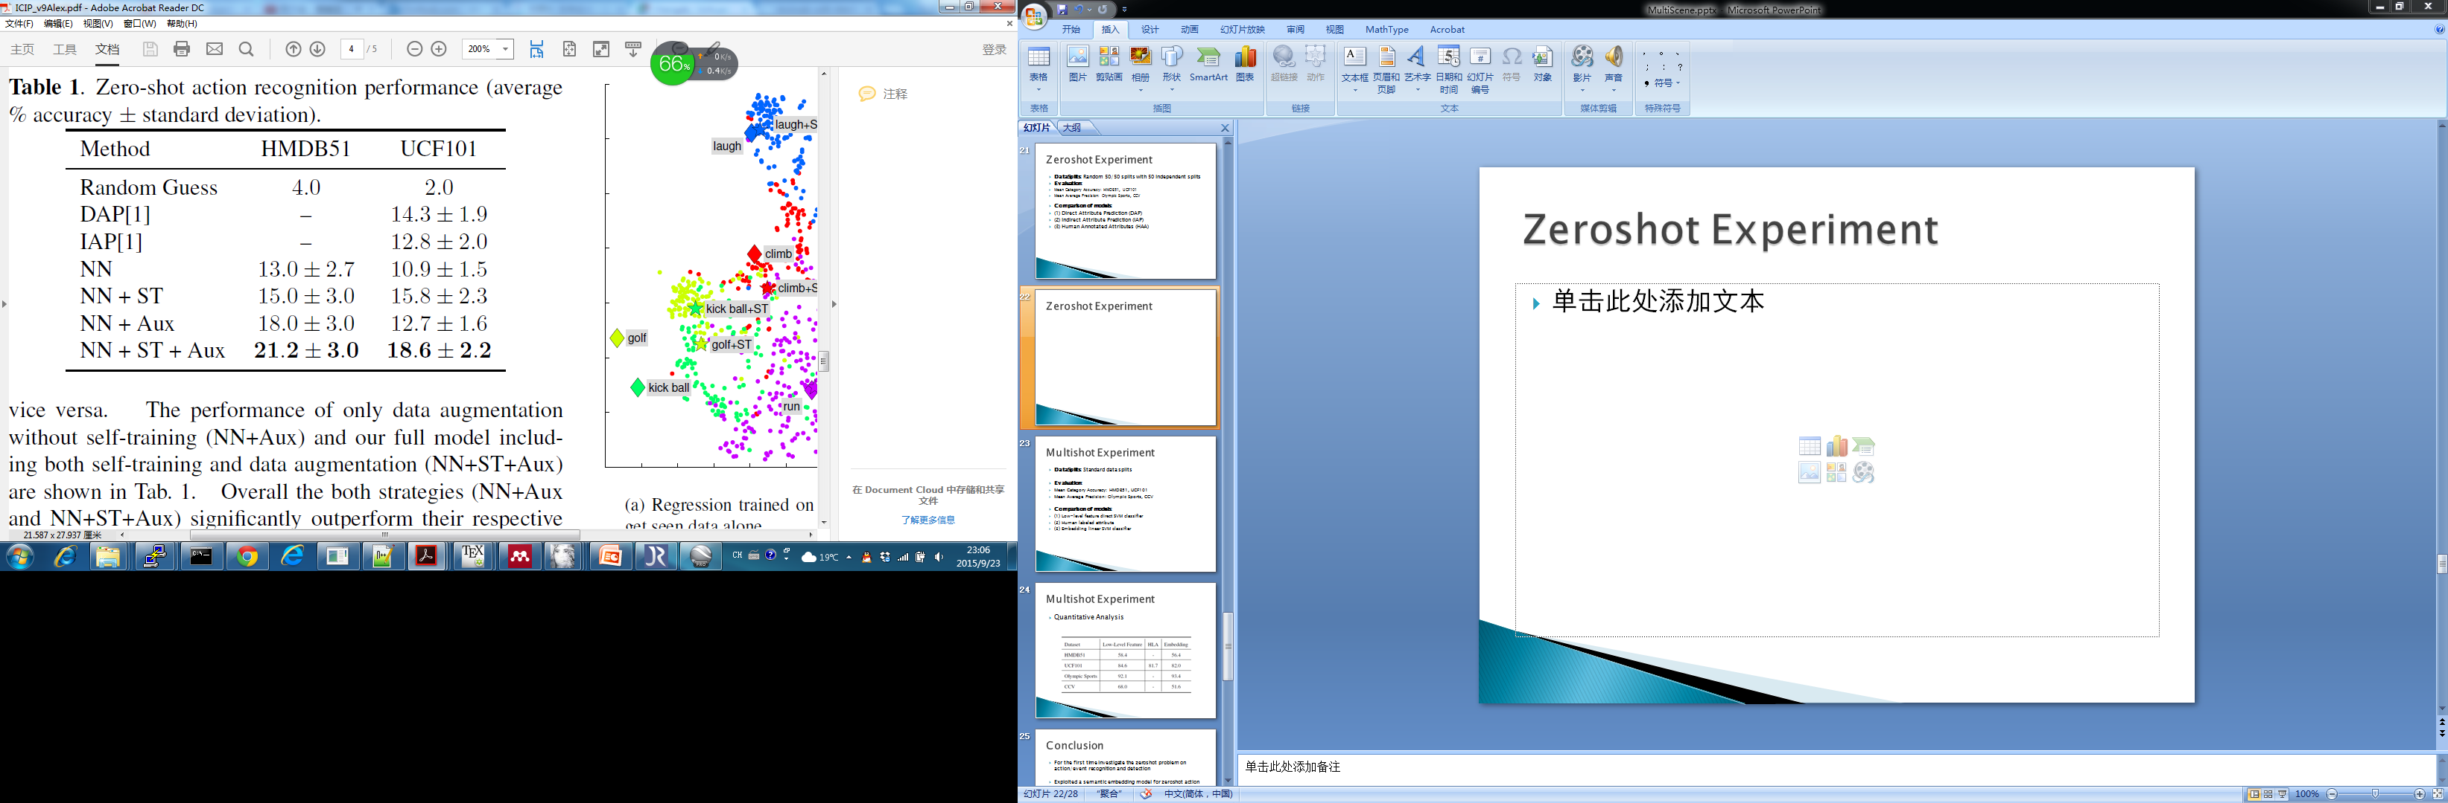
Zeroshot Experiment
Quantitative Evaluation

Slide 30
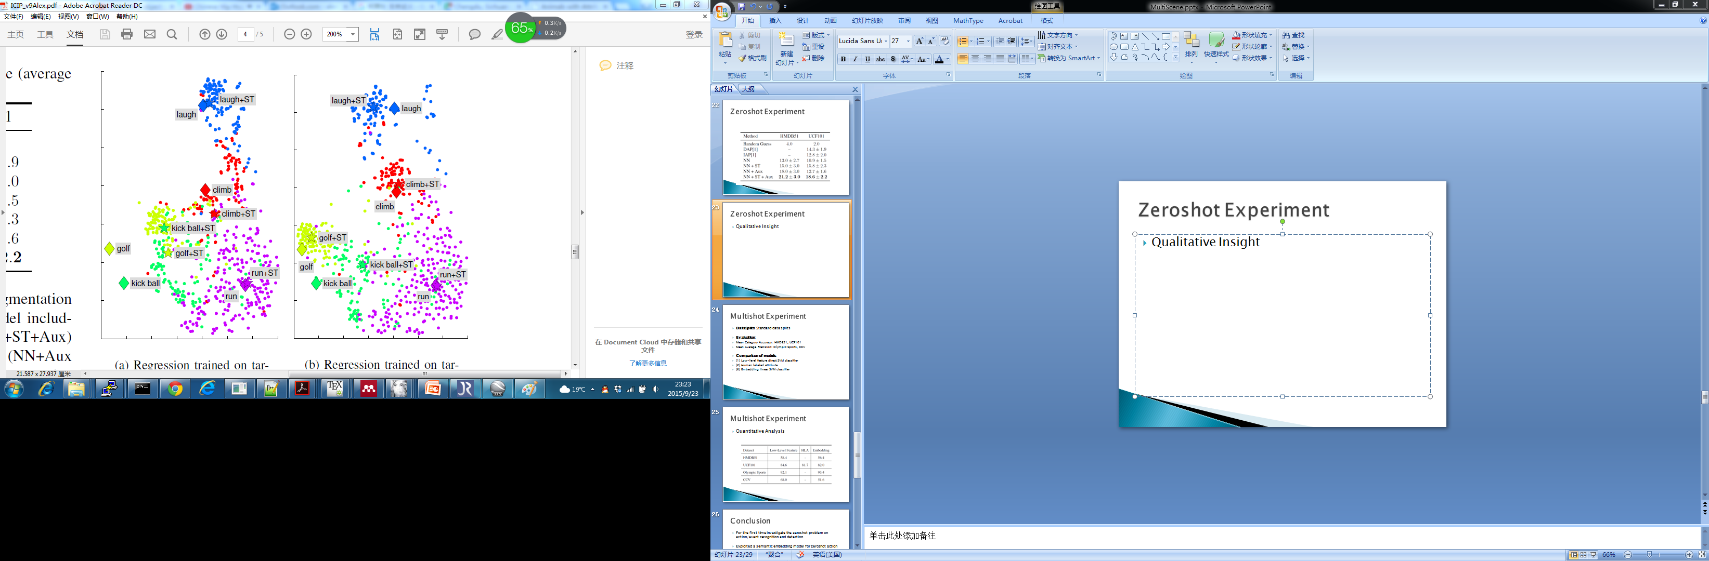
Qualitative Insight
Qualitative Insight
Without Augmentation
With Augmentation

Slide 31
Conclusion
Exploited a semantic embedding model for zeroshot action recognition and detection
We experimented on 2 popular action/event dataset for zeroshot learning.
We proposed the first zeroshot data splits for 2 action/event dataset

Slide 32
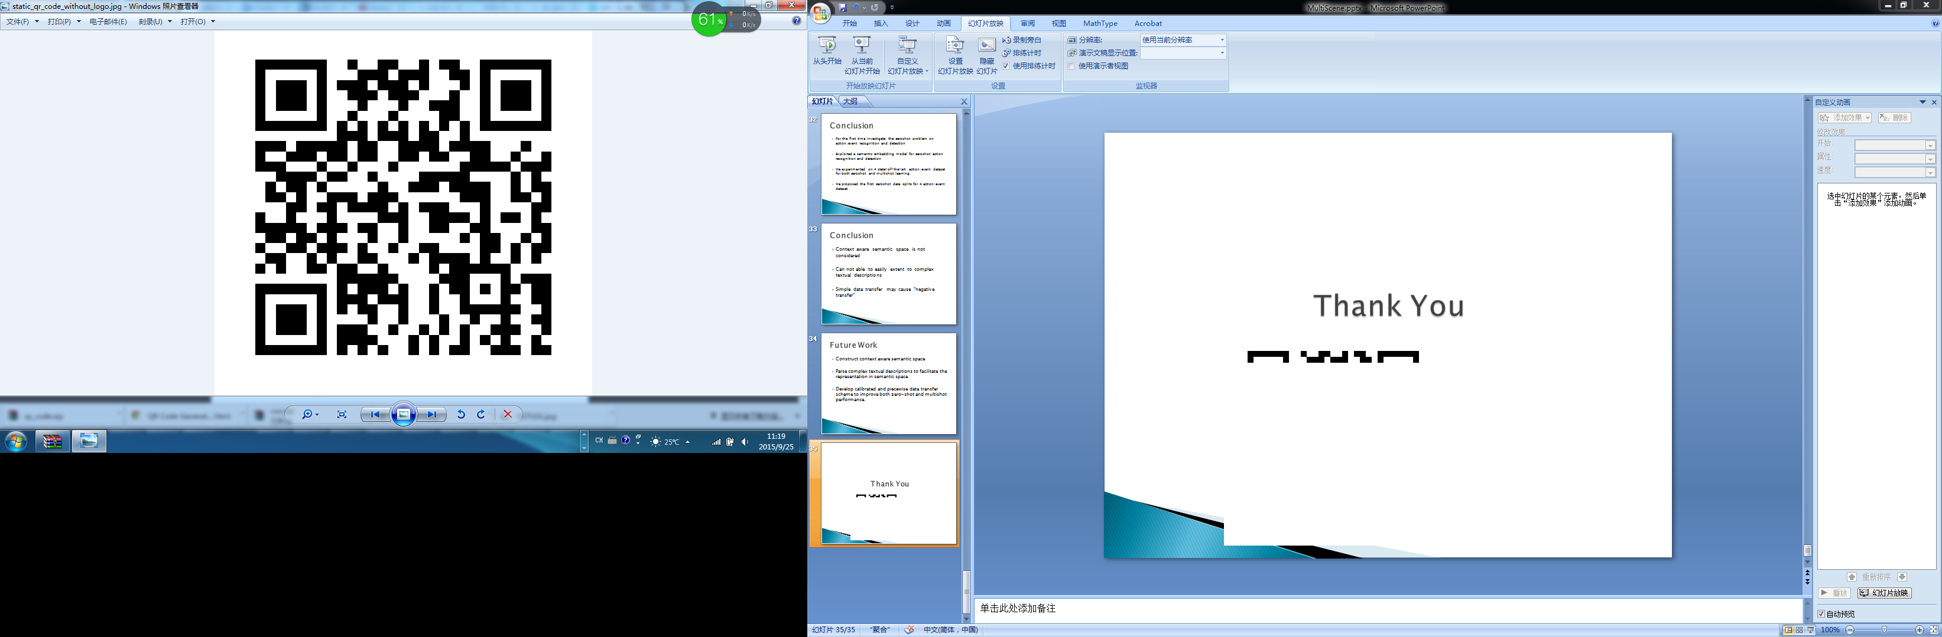
Thank You
Scan Me

Slide 33
Multishot Experiment
DataSplits: Standard data splits
Evaluation:
Mean Category Accuracy: HMDB51, UCF101
Comparison of models:
(1) Low-level feature direct SVM classifier
(2) Human labeled attribute
(3) Embedding linear SVM classifier

Slide 34
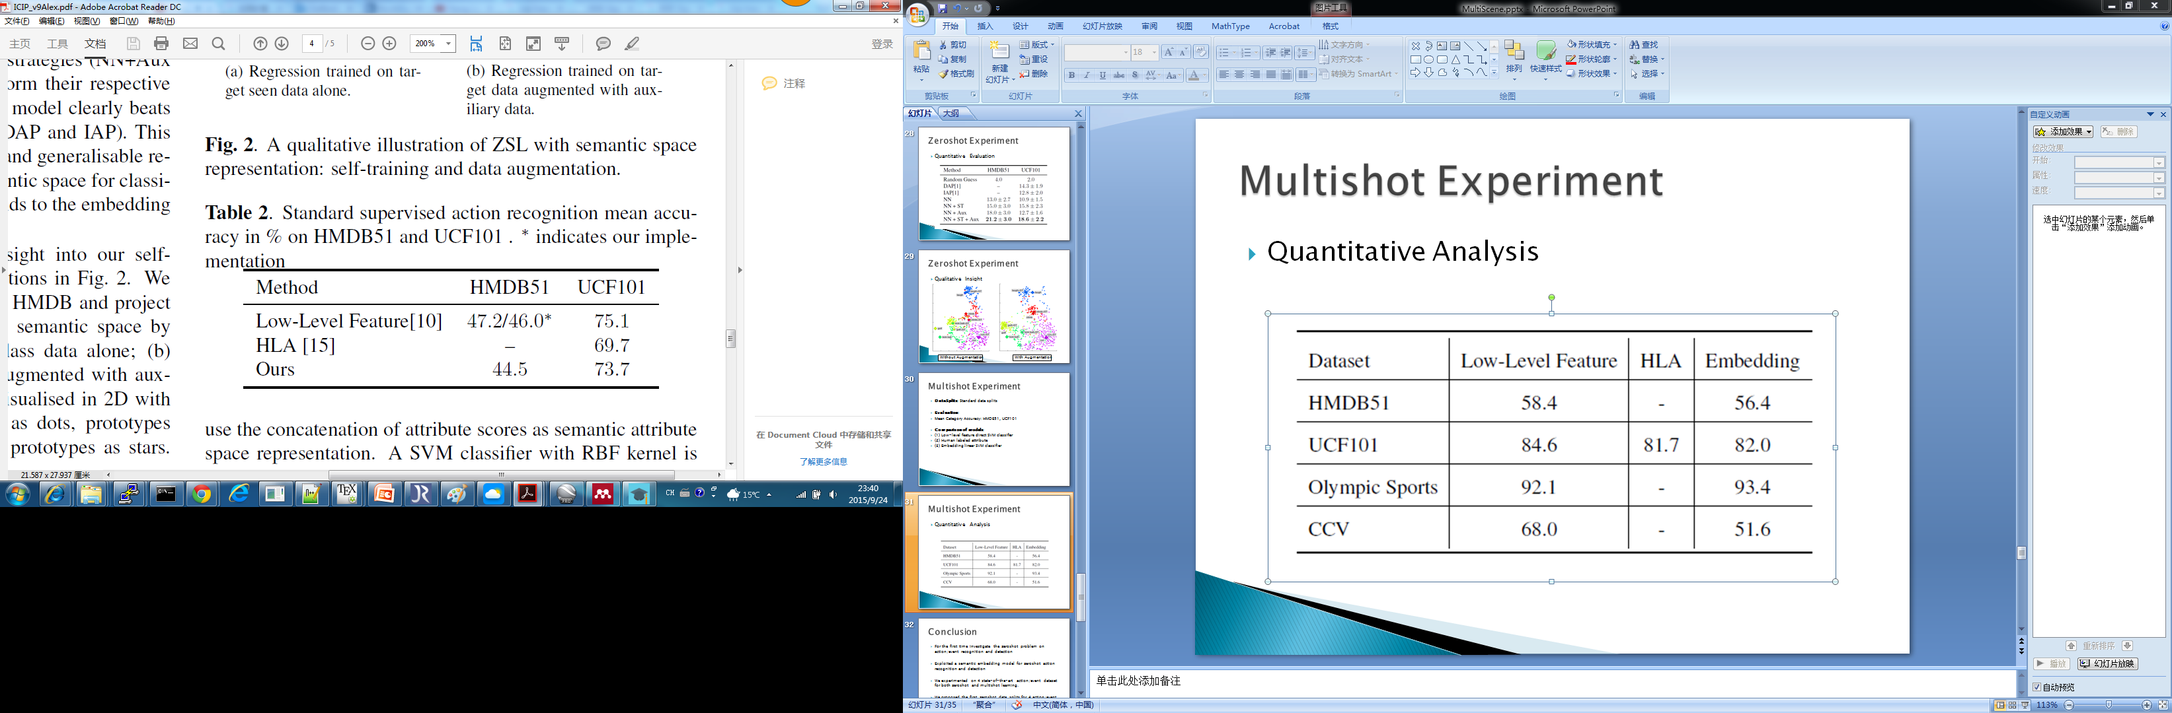
Multishot Experiment
Quantitative Analysis

